Slide 1


Slide 2

VIT
Topic/Course
Sub-Topic (Example: name of college)

Slide 3

DATA ARRANGEMENTS

Slide 4

DATA ARRANGEMENTS
Data Arrangement questions may be asked in the following forms -
Linear Arrangement
Circular Arrangement (inward, outward or both side facing)
Square/Rectangular Arrangement (inward, outward or both side facing)
Combination of the above three with puzzles.

Slide 5
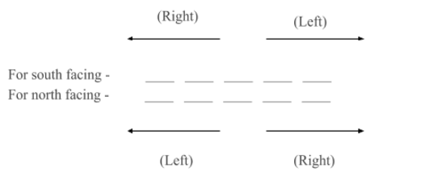
DATA ARRANGEMENTS
1. Linear Arrangement -
This type of question may be asked in a single row or double row arrangement. You need to take special care of the directions of the people here. Suppose 5 people are sitting in a single row.

Slide 6
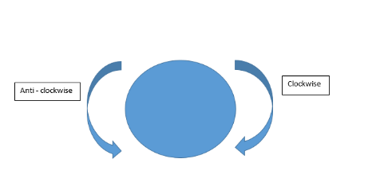
DATA ARRANGEMENTS
2. Circular Arrangement –
This type of question may be asked in following forms –
(a) All the people are facing towards the center
(b) All the people are facing outside the center
(c) Some people are facing inside while some are facing outside the center.

Slide 7
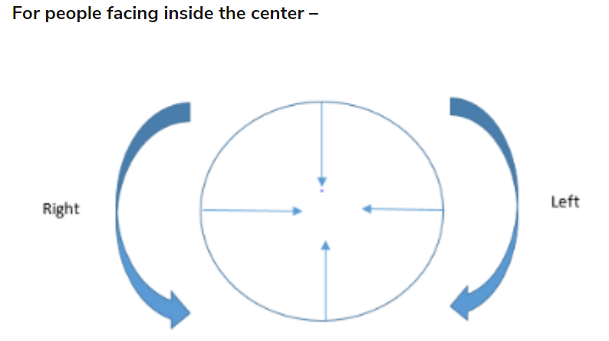
DATA ARRANGEMENTS
As mentioned above, you need to take special care of the directions in such problems.

Slide 8
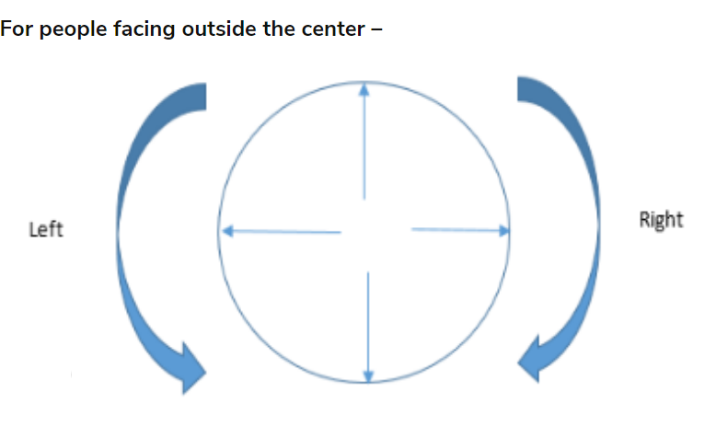
DATA ARRANGEMENTS

Slide 9
DATA ARRANGEMENTS
3. Square/ Rectangular Arrangement -
In this type of arrangement as well, following arrangements are possible -
(a) All the people are facing towards the center
(b) All the people are facing outside the center
(c) Some people are facing inside while some are facing outside the center.
The directions for this arrangement are taken in the same manner as that of a circular arrangement.

Slide 10
Question 1-2
Four boys are sitting on a bench to be photographed. Shekar is to the left of Ramesh. Manish is to the right of Raju. Raju is between Ramesh and Manish.

Slide 11
Question 1
Who would be third from the left in photograph?
A)
Manish
B)
Raju
C)
Ramesh
D)
Shekar
Notes:
Answer: C
Left ____ Manish _____ Ramesh right Manish Raju Ramesh Manish Raju Ramesh Shekar

Slide 12
Question 2
Who would be second from the left?
A)
Manish
B)
Raju
C)
Ramesh
D)
Shekar
Notes:
Answer: B
Left ____ Manish _____ Ramesh right Manish Raju Ramesh Manish Raju Ramesh Shekar

Slide 13
Question 3-7
Six athletes Anu, Benny, Chandru, Dolly, Esha, Furpreet compete in a race. The outcomes are as follows :
1) Exactly 2 swimmers finish ahead of Benny.
2) Only two swimmers separate Esha & Dolly.
3) Anu is behind Dolly & Esha.
4) Benny is ahead of Esha, with one swimmer intervening.
5) Furpreet is ahead of Dolly.

Slide 14
Question 3
Who stood third in the race?
A)
Anu
B)
Benny
C)
Chandru
D)
Dolly
Notes:
Answer: B
From clue 1: __ __ B __ __ __ From clue 4: __ __ B __ E __ From clue 3: __ __ B __ E A From clue 2: __ D B __ E A From clue 5: F D B __ E A Left over person is C. F D B C E AAs it can be clearly seen from the layout, Benny stood 3rd in the race.

Slide 15
Question 4
How many swimmers separate Furpreet and Benny?
A)
One
B)
Two
C)
Three
D)
Four
Notes:
Answer: A
From clue 1: __ __ B __ __ __ From clue 4: __ __ B __ E __ From clue 3: __ __ B __ E A From clue 2: __ D B __ E A From clue 5: F D B __ E A Left over person is C. F D B C E AAs it can be clearly seen from the layout, one person separate Furpreet and Benny (Dolly).

Slide 16
Question 5
Who secured the middle position in the race?
A)
Anu
B)
Benny
C)
Chandru
D)
None of the options
Notes:
Answer: D
From clue 1: __ __ B __ __ __ From clue 4: __ __ B __ E __ From clue 3: __ __ B __ E A From clue 2: __ D B __ E A From clue 5: F D B __ E A Left over person is C. F D B C E AAs we have even number of participants, we cannot have anyone in the middle position.

Slide 17
Question 6
Who wins the race?
A)
Anu
B)
Furpreet
C)
Chandru
D)
Dolly
Notes:
Answer: B
From clue 1: __ __ B __ __ __ From clue 4: __ __ B __ E __ From clue 3: __ __ B __ E A From clue 2: __ D B __ E A From clue 5: F D B __ E A Left over person is C. F D B C E A
From the arrangement, it is clear that Furpreet won the race.

Slide 18
Question 7
How many swimmers finished ahead of Chandru?
A)
One
B)
Two
C)
Three
D)
Four
Notes:
Answer: C
From clue 1: __ __ B __ __ __ From clue 4: __ __ B __ E __ From clue 3: __ __ B __ E A From clue 2: __ D B __ E A From clue 5: F D B __ E A Left over person is C. F D B C E A
Since Chandru secured the 4th position, we can conclude that 3 swimmers finished ahead of him.

Slide 19
Question 8-9
Study the following information to answer the given questions:
Annu, Bansi, Chandani, Deepika, Emmy and Farhan are seated in a circle facing the center. Annu and Chandani are seated adjacent to each other and Emmy and Bansi are also seated adjacent to each other. Bansi is to the immediate left of Farhan. There are two persons between Deepika and Emmy. Annu is not seated adjacent to Emmy.

Slide 20
Question 8
How many persons are seated between Farhan and Emmy if we go anticlockwise from Farhan to Emmy?
A)
1
B)
2
C)
3
D)
0
Notes:
Answer: C
Image: View->Notes page
There are 3 people between Farhan and Emmy.

Slide 21
Question 9
Who is to the immediate left of Chandani?
A)
Annu
B)
Bansi
C)
Farhan
D)
Cannot be determined
Notes:
Answer: A
Image: View->Notes page

Slide 22
Question 10
Five letters are arranged in a row.
1. R is not adjacent to S or A.
2. B is not adjacent to S.
3. R is adjacent to M.
4. M is at the middle in the row.
Then, B is adjacent to whom out of the following ?
A)
R
B)
S
C)
A
D)
Cannot be determined
Notes:
Answer: A
M is in middle. __ __ M __ __ If R is adjacent to M, there are two possibilities:_ _ M R _ or _ R M _ _
R is not adjacent to S or A
_ _ M R B or B R M _ _ ( for the blank space we have possibilities like S A / A S)
From the above possibilities we can see that B is adjacent to R

Slide 23
Question 11
9 people, A to I are seated in a row to be photographed. Their seating arrangement is in accordance with the following conditions:
E sits at the centre.
F and I sit on the corner seats.
H is equidistant from both I and E.
D sits three places to the right of E.
A is two places to the left of D and next to H
G is in between B and C and C is closer to E.
Who is the sixth person from the left end in the photograph?

Slide 24
Question 11
A)
A
B)
B
C)
C
D)
G
Notes:
Answer: C
1. -- -- -- -- E -- -- -- -- 1 2 3 4 5 6 7 8 9
2. a) F -- -- -- E -- H -- I
1 2 3 4 5 6 7 8 9 (or)
b) I -- H -- E -- -- --- F
1 2 3 4 5 6 7 8 9
3. a) F -- -- -- E A H D I
1 2 3 4 5 6 7 8 9 (or)
b) I -- H -- E A -- D F But this combination is not possible
1 2 3 4 5 6 7 8 9
Therefore the correct combination is
F B G C E A H D I
1 2 3 4 5 6 7 8 9
In the photograph, I D H A E C G B F
1 2 3 4 5 6 7 8 9
C is the sixth person from the left end in the photograph

Slide 25
Question 12-15
Six friends Priya, Qutin, Rama, Sachin, Tilak and Umesh are sitting around the hexagonal table each at one corner and are facing the centre of the hexagonal. Priya is second to the left of Umesh. Qutin is neighbour of Rama and Sachin. Tilak is second to the left of Sachin.

Slide 26
Question 12
Who is sitting opposite to Qutin ?
A)
Rama
B)
Tilak
C)
Umesh
D)
Sachin
Notes:
Answer: B
Image: View->Notes page

Slide 27
Question 13
Who is the fourth person to the left of Qutin ?
A)
Priya
B)
Umesh
C)
Rama
D)
Data Inadequate
Notes:
Answer: A
Image: View->Notes page

Slide 28
Question 14
Which of the following are the neighbours of Tilak ?
A)
Umesh and Priya
B)
Priya and Rama
C)
Umesh and Rama
D)
Data inadequate
Notes:
Answer: A
Image: View->Notes page

Slide 29
Question 15
Which one is sitting opposite to Tilak ?
A)
Rama
B)
Qutin
C)
Sachin
D)
Cannot be determined
Notes:
Answer: B
Image: View->Notes page

Slide 30
Question 16-20
There are six fruits A to F, among which two are sweet in taste, two are sour in taste and two are tasteless. They are arranged in a basket circularly.
1) A is adjacent to F.
2) C is not adjacent to either B or E.
3) D is sour in taste and is adjacent to the fruits which are tasteless.
4) Both the sweet fruits are adjacent to each other.
5) A is opposite a tasteless fruit which is not B.

Slide 31
Question 16
Which dish is opposite to F?
A)
A
B)
B
C)
C
D)
D
Notes:
Answer: D
Image: View->Notes page

Slide 32
Question 17
Which of the following is not a correct combination?
A)
C tasteless
B)
F sweet
C)
D sour
D)
E sour
Notes:
Answer: D
Image: View->Notes page

Slide 33
Question 18
Which dishes are adjacent to D?
A)
A and C
B)
E and C
C)
D and F
D)
A and E
Notes:
Answer: B
Image: View->Notes page

Slide 34
Question 19
Which of the following is true?
A)
One of the tasteless fruit is opposite to sour fruit
B)
A sour fruit is opposite to a sweet fruit
C)
A is a sweet fruit
D)
More than one of the options
Notes:
Answer: D
Image: View->Notes page

Slide 35
Question 20
Which of the following fruits can be together?
A)
B and E
B)
D and F
C)
B and C
D)
A and B
Notes:
Answer: A
Image: View->Notes page

Slide 36

THANK YOU

